Slide 1
Coaching for Competence and Confidence
Dale L. Cusumano, Angela I. Preston, and Caryn S. Ward
University of North Carolina Chapel Hill
March 2018

Slide 2
Key Findings
Implementation research has clarified the critical role of coaching:
Practitioners who have the support of coaches are far more likely to use effective innovations in practice
The Joyce and Showers (2002) meta-analysis found an improvement from 5% for training-only to 95% for training-and-coaching.
Schoenwald, Sheidow, and Letourneau (2004) found that high fidelity coaching was associated with high fidelity use of the evidence-based program and had a significant impact on program outcomes.
Thus, coaching is not a title but a set of skills that support best practices and behavior change efforts (Joyce & Showers, 1988; Neufeld & Roper, 2003; Stollar et al., 2008

Slide 3
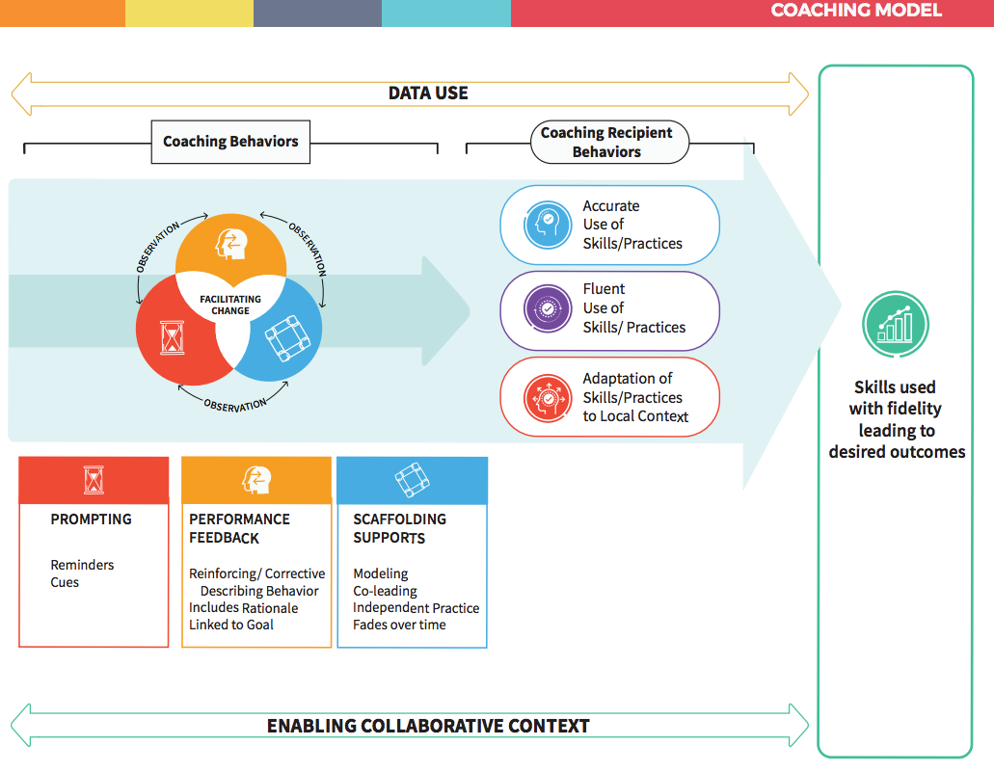
Essential Components of Coaching
Prompting
Scaffolding
Delivering performance feedback
Using data
Creating an enabling and collaborative context
Notes:
© 2018 Cusumano, Preston, and Ward

Slide 4

Copyright
This content is licensed under Creative Commons license CC BY-NC-ND, Attribution-NonCommercial-NoDerivs . You are free to share, copy, distribute and transmit the work under the following conditions: Attribution — You must attribute the work in the manner specified by the author or licensor (but not in any way that suggests that they endorse you or your use of the work); Noncommercial — You may not use this work for commercial purposes; No Derivative Works — You may not alter, transform, or build upon this work. Keep the original slide deck with GIS logo intact when using. Any of the above conditions can be waived if you get permission from the copyright holder (the authors).

