Slide 1
welcome
welcome

Slide 2
Your Presenter Today: Dr. Maura Hart
Dr. Maura Hart has over 25 years of experience supporting teachers and administrators in their professional learning journeys in her work with classroom teachers, school and district administrators, education graduate study students, pre-service teachers, and in her facilitation of teams at the school, district and state level. She began her career as a middle and high school Language Arts and English teacher in NH and VT. Currently, Maura Hart is a Technical Assistance Provider with the Center for Inclusive Education at the Institute on Disability at the University of New Hampshire and an adjunct faculty member of the Education Department of Antioch University. She is passionate about supporting all students to learn in the general education classroom and has focused her work on this objective throughout her career. Since her first day in the classroom, intuitively, Maura saw the need for information and strategies to support systemic improvement. She was thrilled to discover the Stages and Drives of Implementation Science in her work with the SWIFT Center at KU and has been applying the concepts in her work with school and district teams supporting them to implement continuous cycles of improvement. She lives on a small farm (which is really just an expensive Petting Zoo) in Plainfield, NH with her husband and 3 teenage daughters. In her spare-time she teaches Jazzercise, hikes in the woods, skis both downhill and cross country and spends as much time with her family as she can.

Slide 3
The What and How of Implementation Science
The Global Implementation Society
Maura Hart, Ed. D.
February 5, 2019

Slide 4
Welcome to the Global Implementation Society
Benefits | The GIC 2019 Conference
Membership in a community of professionals providing human services in a variety of service sectors Access to members only educational resources Reduced registration fees for the Global Implementation Conference and other education events | September 15 – 17, 2019 Glasgow, Scotland https://gic.globalimplementation.org/ GIC 2019 Conference Theme: Implementation for Impact

Slide 5
Our Work Today
Agenda:
Objectives:
This webinar will provide an opportunity to enhance the participant’s knowledge to implementation practice, science and policy.
The Big Picture: What is Implementation Science?
Understanding Stages, Drivers and Fidelity
Facilitating Implementation Science: teaming, data, communication
This learning opportunity is intended for those “new to” implementation science.
Identify and Connect as a learning community
Assess what we know now
Construct understandings of key components of applied Implementation Science
Investigate Strategies for facilitation using Implementation Science constructs
Assess what we now know
Identify future topics and share resources

Slide 6
Who is here today?
Type in the Chat:
Where you are Located
Your Area of Focus
Your Role

Slide 7
Establishing Prior Knowledge
I can articulate the what and why of “Implementation Science” (slides 9, 10, & 12)
I know what “evidence based practice” means
I understand the value of using Implementation Science in a continuous cycle of improvement
I understand methods and purposes of “fidelity checks” for both innovation and process
I can explain the Stages and Drivers of Implementation Science as they relate to the continuous cycle of improvement
I recognize the role teams play in Implementation Science
I can explain key components of effective implementation teams and relate these components to successful facilitation strategies
I can summarize the value of the use of data to inform and steer the continuous cycle of improvement

Slide 8
The Big Picture: Implementation Science
Seriously… what is it?

Slide 9
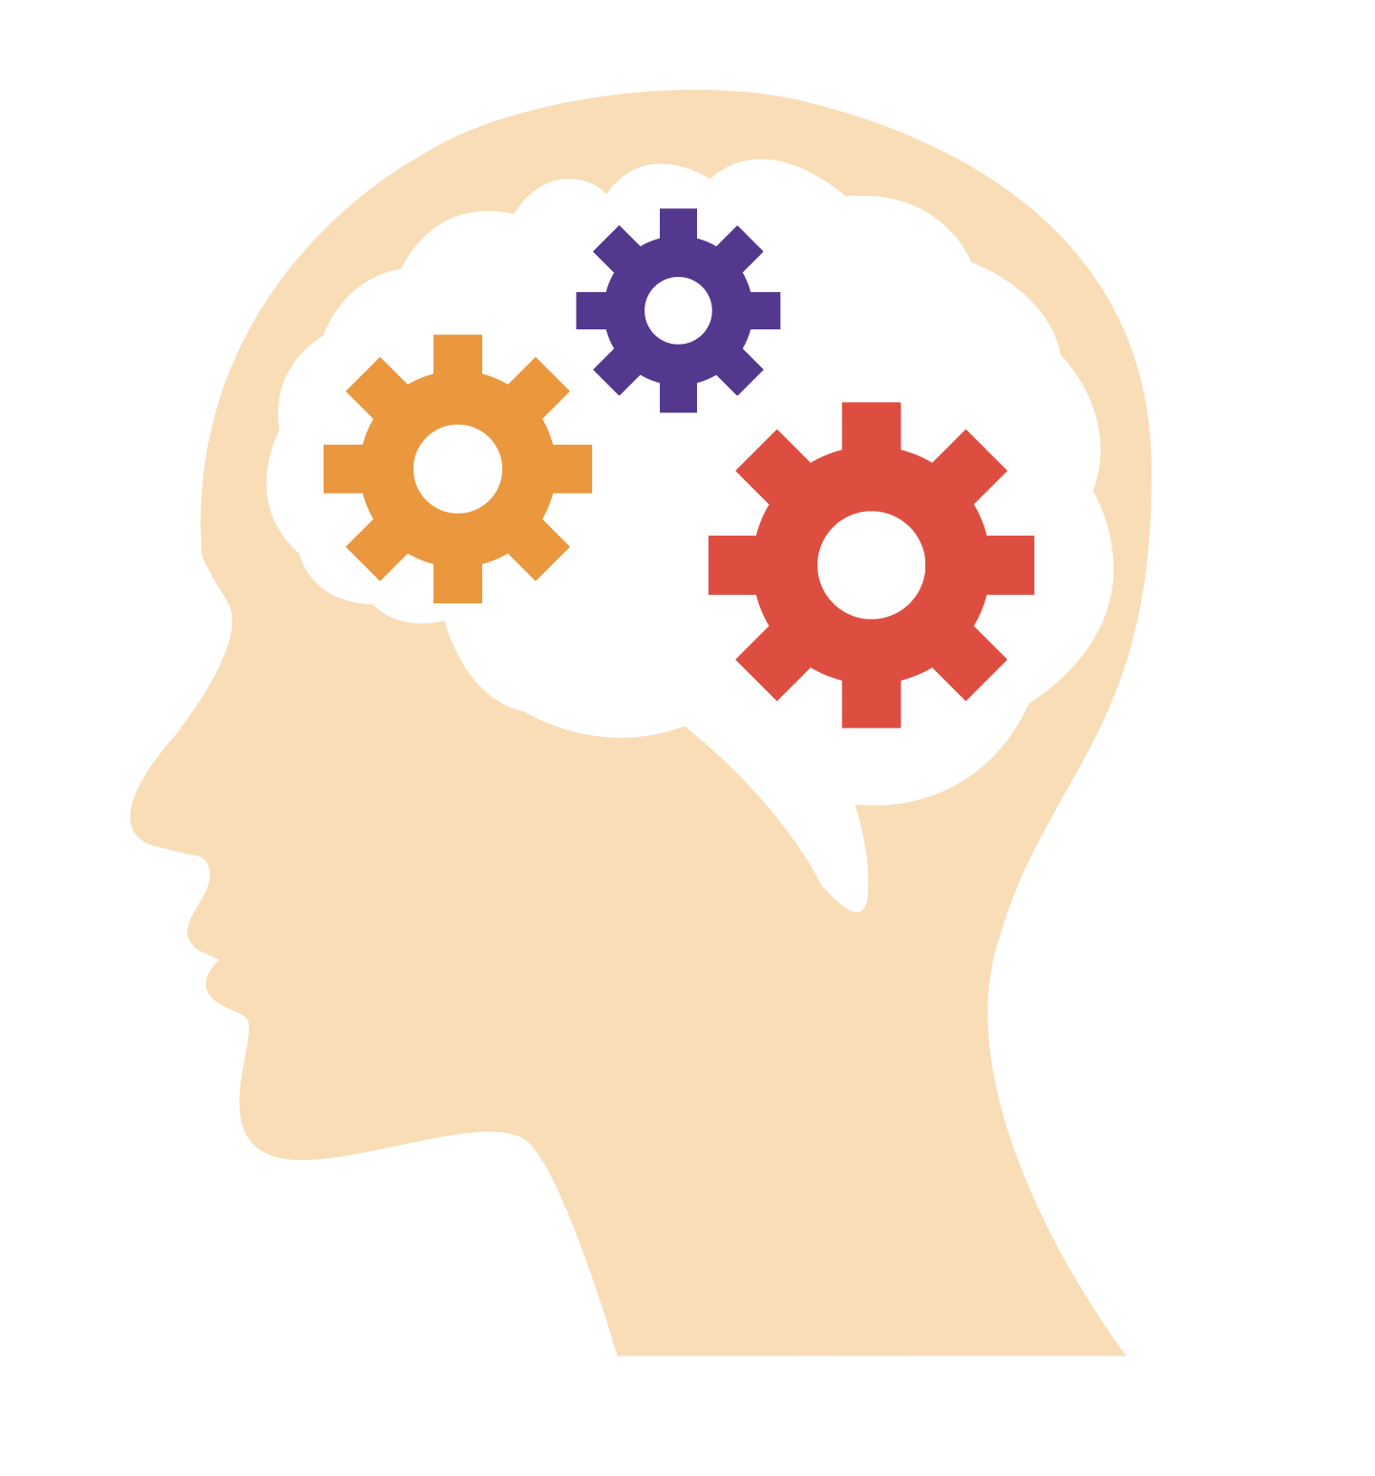
Implementation Science
The study of factors that influence the full and
effective use of innovations in practice.
Applied Implementation Science
The purposeful use of implementation best
practices to promote the systematic uptake,
sustainability, and use of effective and
locally appropriate evidence-based practices
and programs.

Slide 10
Key Concept: Evidence Based Practice
An evidence based practice is an innovation determined to be effective when used as intended.
Criteria that make a practice or innovation evidence based can be:
Local and research informed data to show the innovation is effective;
The innovation is supported with a performance (fidelity) assessment to indicate the presence and strength of the innovation in practice;
The performance assessment results are correlated with the intended outcomes of the innovation
From: National Implementation Research Network. Retrieved January 3, 2019. From: https://implementation.fpg.unc.edu/module-6/topic-1-defining-usable-innovations

Slide 11
Why Implementation Science?
The implementation of evidence based practice in any human service delivery sector is incredibly complex. Why?
People
Values
Systems
Multi-tiered organizational structures with diverse stakeholders
You will do better if your work is informed by Implementation Science and best practices

Slide 12
Implementation Drivers
Reliable and Socially Significant Outcomes
Consistent and Competent Use of Effective Innovations
Help to develop, improve, and sustain practitioners’ and providers’competence and confidence to implement effective programs and practices
Help ensure sustainability and continuous improvement at the practice, organization & system levels
Competency Drivers
Organization Drivers
Integrated & Compensatory
Integrated & Compensatory
Leadership Drivers
© Fixsen & Blase, 2008
Help guide leaders to use the right leadership strategies for the situation
Notes:
12

Slide 13
Implementation Drivers
Reliable and Socially Significant Outcomes
Consistent and Competent Use of Innovations
Performance Assessment/Fidelity
Coaching
Competency Drivers
Organization Drivers
Training
Integrated & Compensatory
Integrated & Compensatory
Selection
Leadership Drivers
© Fixsen & Blase, 2008
Notes:
13

Slide 14
Implementation Drivers
Reliable and Socially Significant Outcomes
Consistent and Competent Use of Innovations
Performance Assessment/Fidelity
Coaching
Systems
Intervention
Competency Drivers
Facilitative
Administration
Training
Organization Drivers
Integrated & Compensatory
Integrated & Compensatory
Selection
Decision Support
Data System
Leadership Drivers
© Fixsen & Blase, 2008
Notes:
14

Slide 15
Implementation Drivers
Reliable and Socially Significant Outcomes
Consistent and Competent Use of Innovations
Performance Assessment/Fidelity
Coaching
Systems
Intervention
Competency Drivers
Facilitative
Administration
Training
Organization Drivers
Integrated & Compensatory
Integrated & Compensatory
Selection
Decision Support
Data System
Leadership Drivers
© Fixsen & Blase, 2008
Technical
Adaptive
Notes:
15

Slide 16
Implementation Drivers
Reliable and Socially Significant Outcomes
Consistent and Competent Use of Innovations
Performance Assessment/Fidelity
Coaching
Systems
Intervention
Competency Drivers
Facilitative
Administration
Training
Organization Drivers
Integrated & Compensatory
Integrated & Compensatory
Selection
Decision Support
Data System
Leadership Drivers
© Fixsen & Blase, 2008
Technical
Adaptive
Notes:
16

Slide 17
Key Word: Fidelity
Of Innovation
Of Process
Are we applying the components of Implementation Science to the implementation process as intended?
Are we implementing the practice as intended?
Making sure we are getting it right along the way

Slide 18
Key Word: Fidelity
Adaptation
Purposeful modification based on context
Drift
Unintentional Low Fidelity
Using process and outcome data
Communication and support
No regular review of data (process or outcome)
Little or ineffective communication and support

Slide 19
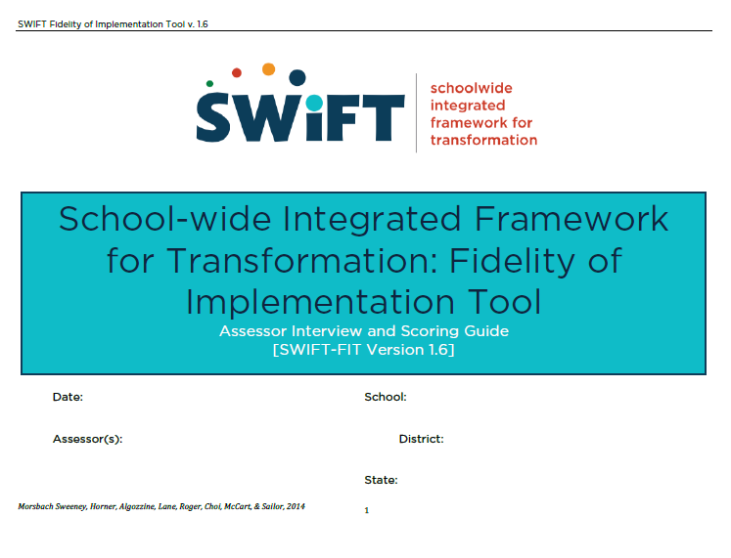
Example: Fidelity Tool for Innovations
Using data to identify the need. Establishing a common understanding of the “Why”

Slide 20
Using data to identify the need. Establishing a common understanding of the “Why”

Slide 21
The Stages of Implementation
Fixsen and Blase 2006-20012

Slide 22
Processing Information
Drivers of Implementation
Competency Selection Training Coaching
Organization Systems Intervention Facilitative Administration Decision Support Data System
Leadership Technical Adaptive
If you had to choose one driver in your current system that is either thriving or lacking, what would it be and why?

Slide 23
Boots on the Ground
Key focus areas of an Implementation Specialist

Slide 24
Interplay of People and Systems
“Go slow to go fast”

Slide 25
The Keystone of Success
teaming
communication
Roles, structures, procedures
Balance of time and voice
Common understanding of purpose
Common understanding of the what and how of decision making
Alignment: systems, policies and procedures
Gather input (Stakeholders)
Multiple approaches and Repetition
Feedback loops for improvement
Common understanding

Slide 26
Facilitation 101
Establish safety and equity
Balance voice and time
Introduce, utilize and reflect on processes (teaming, implementation)
Teach facilitation of large and small groups
Focus on outcomes (small and large)
Focus on shared understandings of innovation and effective implementation processes

Slide 27
Summarizing Learning
Please write key words in the chat box to summarize what you have learned, been reminded of, or are thinking about.

Slide 28
Post Assessment
I can articulate the what and why of “Implementation Science” (slides 9, 10, & 12)
I know what “evidence based practice” means
I understand the value of using Implementation Science in a continuous cycle of improvement
I understand methods and purposes of “fidelity checks” for both innovation and process
I can explain the Stages and Drivers of Implementation Science as they relate to the continuous cycle of improvement
I recognize the role teams play in Implementation Science
I can explain key components of effective implementation teams and relate these components to successful facilitation strategies
I can summarize the value of the use of data to inform and steer the continuous cycle of improvement

Slide 29
What Else?
About what would you like to know more?
Please list webinar topics in the chat box.

Slide 30
Did We Do What We Said We’d Do? (Fidelity of Webinar Implementation)
Identify and connect as a learning community
Assess what we know now
Construct understandings of key components of Implementation Science
Investigate and formulate strategies for facilitation using Implementation Science
Assess what we now know
Identify future topics and share resources

Slide 31
Thank you!
AI HUB
Global Implementation Society
Webinar Evaluation
Presenter Contact Information:
Email: maura.hart@unh.edu
Phone: 603.359.2748

Slide 32
Thank you.
welcome
welcome

