Slide 1
From pilot to scale up of Population Health and Environment (PHE) Integration in East Africa
Global Implementation Society Webinar
November 12, 2020
Kabiswa Charles
Programs Director
Ecological Christian Organisation

Slide 2
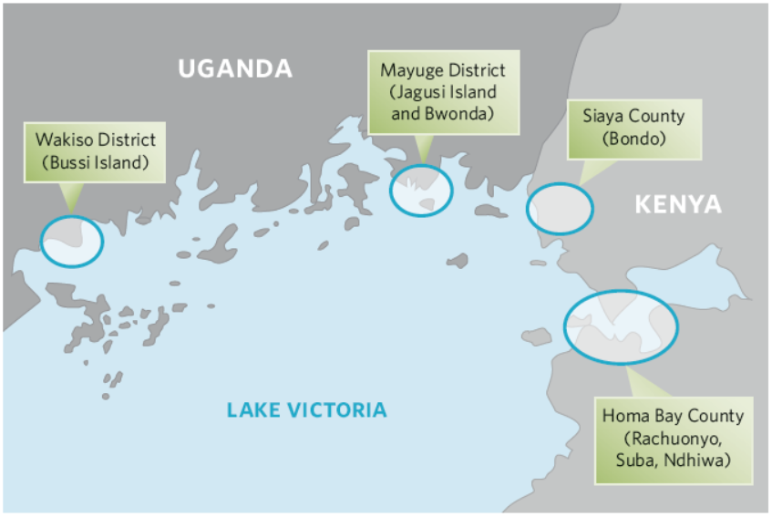
The Health of People and Environment in the Lake Victoria Basin (HoPELVB)
Total pilot target population
UG (92,400) and KE (40,000)
Phase I pilot (2012 – 2014)
Phase II testing scale up (2015-2017)
Implementers: Pathfinder International, ECO, CTPH, OSIENALA, other environmental and health NGOs
Funders: USAID, MacArthur, Packard, Barr and Winslow Foundations

Slide 3
Health of People and Environment in the Lake Victoria Basin Project (HoPE-LVB) Phase I, 2011-2014
Goal:
To reduce threats to biodiversity conservation and ecosystem degradation in the Lake Victoria Basin (LVB) while simultaneously increasing access to family planning and reproductive health and to improve maternal and child health.
Strategic Objective:
Develop and demonstrate/test a model for population, health and environment (PHE) integration in Lake Victoria region sites that can be adapted and scaled up in communities, as well as by local, national and regional governments.

Slide 4
HOPE-LVB Integrated PHE Model
Key Interventions:
Key Processes :
Population
Provision of Family Planning info & services
Health
Reproductive Health
Maternal Health
Water Hygiene & Sanitation
Nutrition
Environment
Sustainable fishing
Sustainable agriculture
Biodiversity Conservation
Sustainable livelihood Diversification
Participatory needs assessment
Community engagement
Building capacity through training & supervision
Systems strengthening
Participatory monitoring & reporting
Advocacy
Model Household
Gender mainstreaming and youth
Notes:
HoPELVB is addressing head-on the challenges of food security, nutrition, unmet need for family planning health, environment degradation, maternal and infant mortality and climate change, energy, water sanitation and hygiene, gender equality and lack of economic/livelihood opportunities.

Slide 5
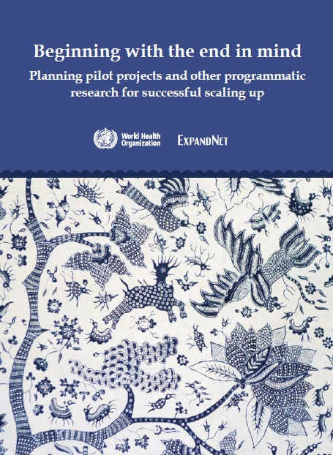
HoPE-LVB began and was implemented with sustainable scale up in mind
Planning for scale up began with the design of the project
Implementation was strategically managed for sustainability and future scale-up success using ExpandNet/WHO guidance
Notes:
This presentation gives an overview of how HoPE has maintained a focus on future scale up from the earliest stages and throughout testing and implementation of the pilot. Here are the three broad stages that we have gone through so far.

Slide 6
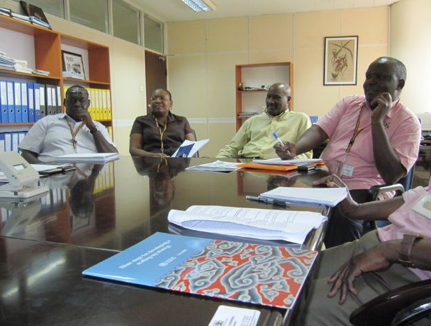
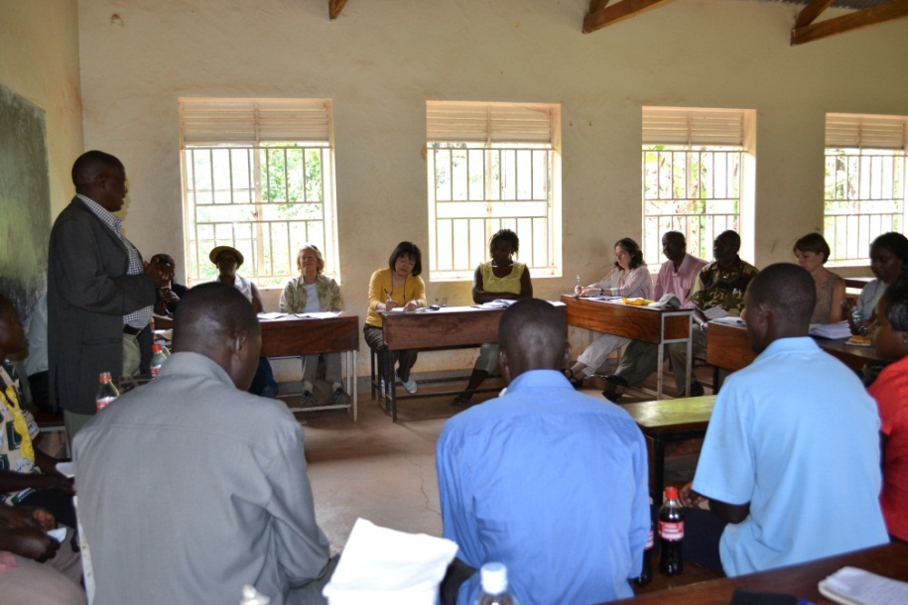
Involving key stakeholders from community, district/county, national and regional levels
National Population Council

Slide 7
HoPE-LVB approaches analyzed along several dimensions
Periodically analyzed how the project was doing against the recommendations from the guide
Feasibility, relevance, practicality, affordability & timeliness
Free from negative effects on other processes/ activities/ ecosystem
Support from key stakeholders (various levels)
Consistent with existing regional, national plans, policies, priorities and service modalities
Potential for sustainability & scalability

Slide 8
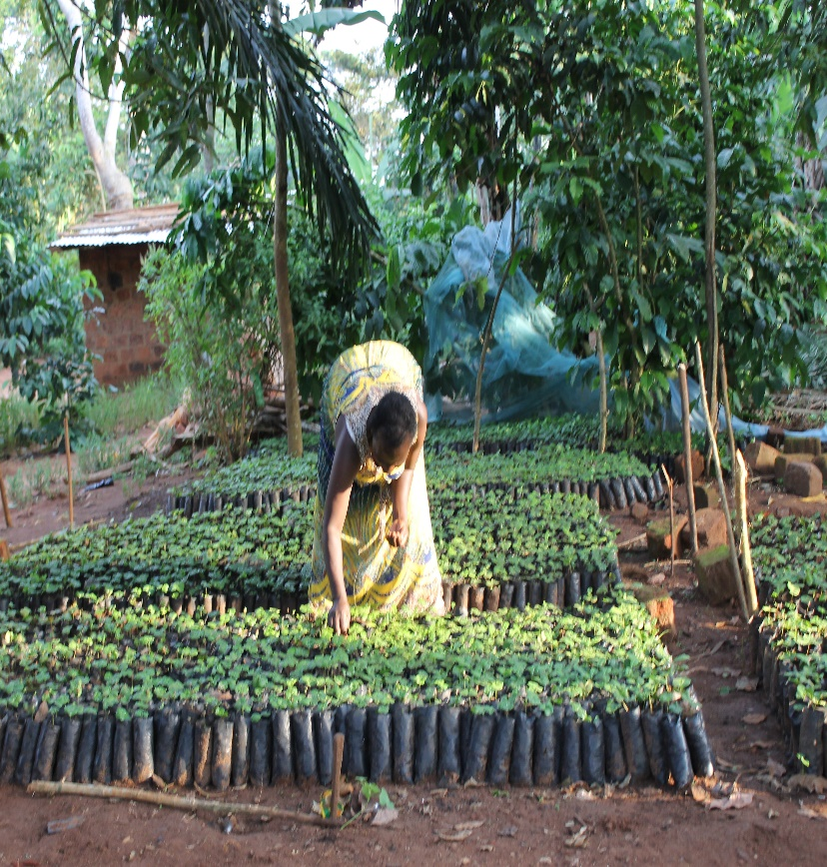
HoPELVB model tested in routine operating conditions and existing resource constraints to extent possible (an example)
WHAT WAS INITIALLY PLANNED:
Agro-forestry interventions implemented primarily by project personnel with communities in model households
….AFTER GROUP ANALYSIS BECAME:
Agro-forestry interventions implemented jointly with district/county environmental officers, subcounty environment officials, village environmental committees, and community members

Slide 9
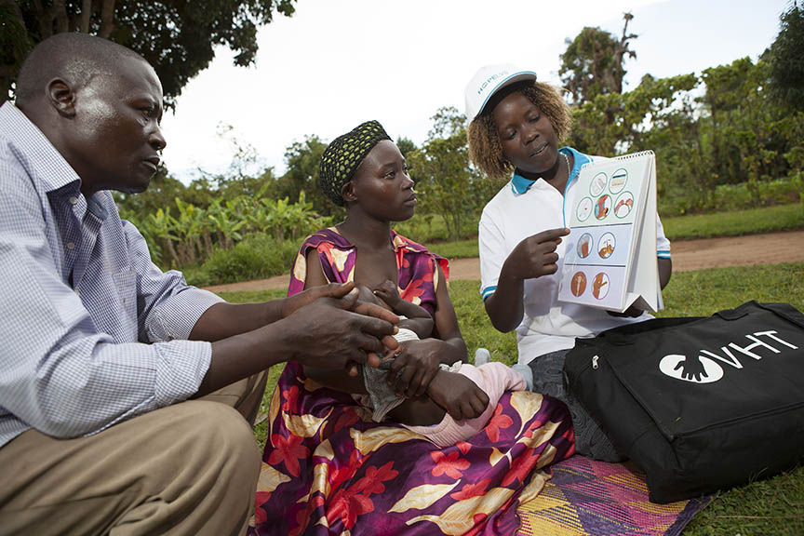
“One thing that I like about the approach HoPE-LVB uses is utilizing the [MOH] Community Strategy… using our CHWs and using that strategy, they didn’t employ other institutions, they use the already existing structures… already developed in the community.”
- Suba sub-county RH Coordinator, Homa Bay, Kenya

Slide 10
Sourcing for funds and support beyond the pilot stage
Begun during the pilot phase engaging broad range of possible supporters, to ensure that the scaling-up process can proceed:
Reaching out to current & new donors and stakeholders to garner interest in adopting and implementing the integrated approach
Work closely with National Population Council, LVBC to institutionalize PHE approaches in their programming and throughout member-nation policies and action plans
Targeting potential new “user organisations” in the PHE networks

Slide 11
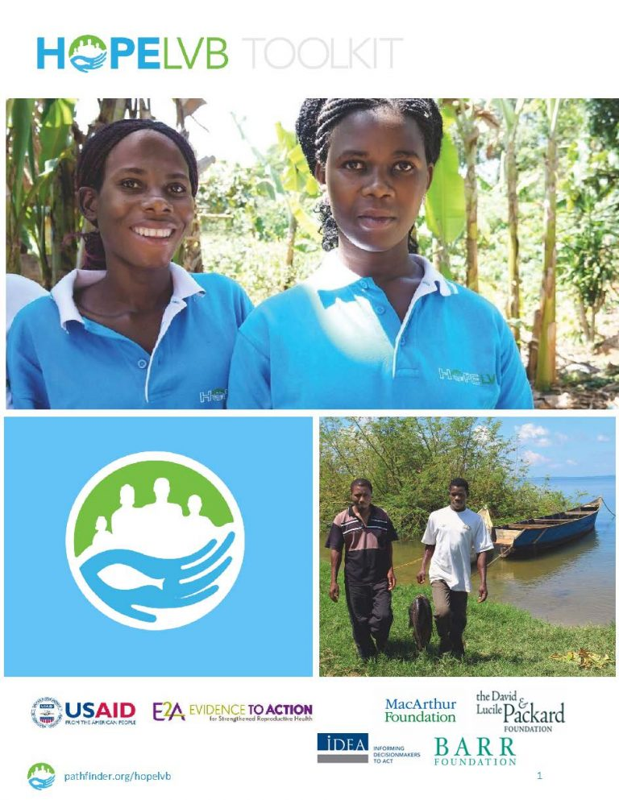
HoPELVB’s examples of documentation and sharing lessons and first-hand experiences
Technical toolkit to support adoption of HoPE integrated approaches
Build capacity of GOs/NGOs
Key lessons from HoPE’s experience with scale up
Share learning from the HoPE scaling-up experience with the wider family planning, global health and development communities via varied dissemination mechanisms

Slide 12
Necessary changes in policy, frameworks and plans from above and below
Policy mapping
PHE champions/steering committees
National & Local Government Development Plans
Targeting EAC/LVBC, NPC and line ministries
Climate Change Policy in Uganda
HoPE’s Model households in MoH community health worker policy doc in Uganda
Uganda Costed Implementation Plan for FP

Slide 13
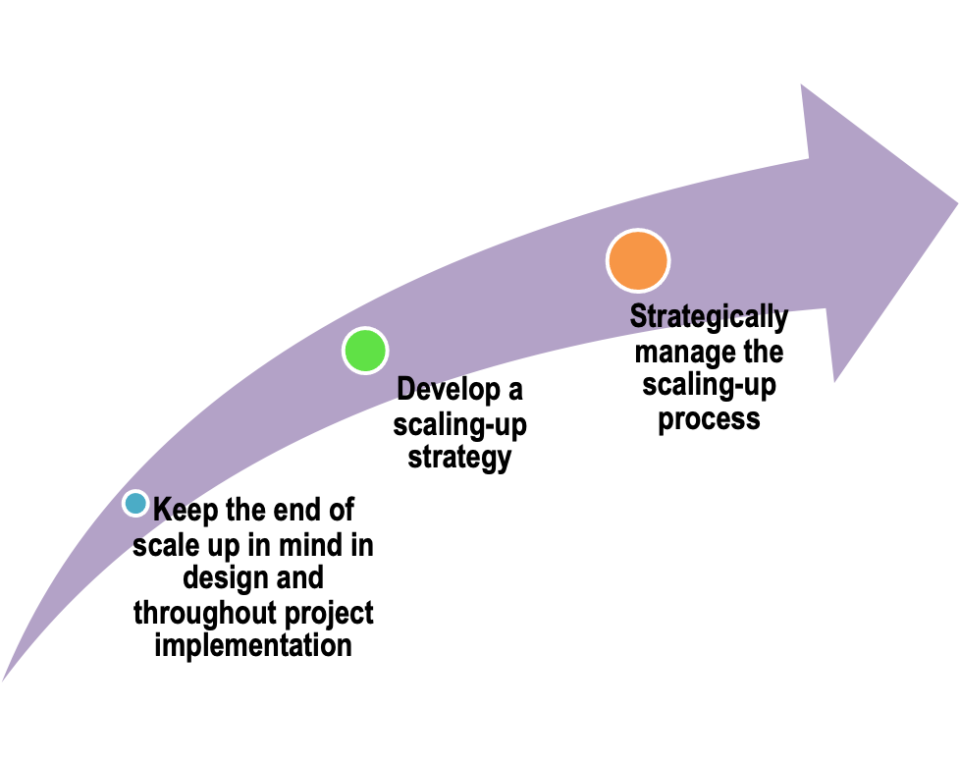
ExpandNet scaling up trajectory
HoPE Phase III (2017 and beyond)
HoPE Phase II (2015-2017)
HoPE Phase I
(2012-2014)

Slide 14
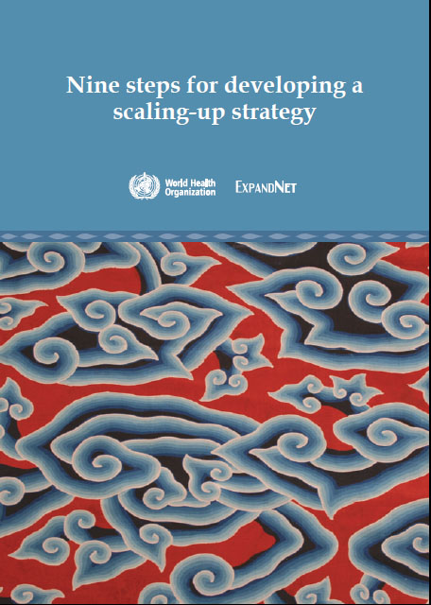
Nine step scaling up strategy development workshops held early in HoPE’s Phase II in Kenya and Uganda, with support from ExpandNet
Notes:
14

Slide 15
Phase II of HoPE-LVB (2015-2017)
PROJECT GOAL:
By 2017, institutionalize the use of HoPE's integrated Population-Health Environment (PHE) approach in the Lake Victoria Basin (LVB) as a model for sustainable development
OBJECTIVES. By 2017 to:
#1: Define and package the HoPE-LVB integrated PHE model in order to disseminate the approach and facilitate capacity building of other organizations to replicate the model
#4: Identify and support program and advocacy mechanisms that promote multi-sectoral planning and management for an integrated approach to sustainable development

Slide 16
Examples of key outcomes from HoPE’s scaling up strategy development efforts in Uganda
NPC support PHE coordination with cross-sectoral representation of line ministries and CSOs under National PHE Network
PHE integrated into NPC Strategic Plan 2020-2026
NDP-III 2026 funded under Environment and Behaviour changes programmes
National PHE strategy in place with funding from government, CSOs & LVBC
Currently 10 PHE projects are active in 10 Districts
New funding streams and partners for PHE work in new areas in Uganda e.g. ECO, CTPH
PHE courses into university curriculum of two universities

Slide 17
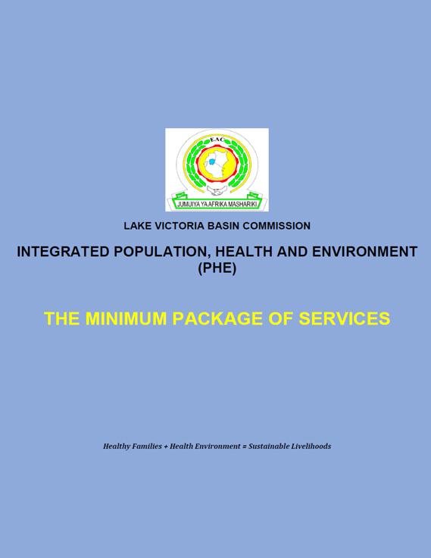
PHE Institutionalization Reflected in East African Community (EAC) Policies and Plans
EAC PHE Strategic Plan (2015-2020)
LVBC PHE Operational Plan (2015-2020)
LVBC PHE M&E Framework (2015-2020)
EAC/LVBC PHE Minimum Package of Services (2015)
PHE training guidelines
Regional PHE Prototype Curriculum
Regional PHE Conference held as a platform for experience sharing
KM products developed to promote advocacy and adoption of the PHE approach

Slide 18
Conclusions
HoPE has provided an illustrative example for diverse projects/fields to planning and implementing scale up
Scale up requires taking time for reflection and planning process from pilot project to larger scale impact
Single-sector vs. multi-sectoral PHE interventions.
Policy and institutional frameworks support scale-up
Decision makers, organisations and funding partners need to be convinced by evidence, good documentation and first hand experience.
Funding streams tend to be highly verticalized, even within district and sub-county budgets, making scale up of integrated approaches harder

